Slide 1
YOUR HEALTH
YOUR HEALTH APP TELLS SOME DISEASES RELATED TO SKIN AND BRAIN AT EARLIER STAGES TO AVOID HOSPITALIZATION AND REDUCES EXPENSES.

Slide 2
ACKNOWLEDGEMENT
It gives us a great sense of pleasure to present the synopsis of the B Tech Mini Project undertaken during B.Tech. Third Year. We owe a special debt of gratitude to Mr. Pawan Kumar Pal, Department of Computer Science, KIET Group of Institutions, Delhi- NCR, Ghaziabad, for his/her constant support and guidance throughout the course of our work. His sincerity, thoroughness and perseverance have been a constant source of inspiration for us. It is only his/her cognizant efforts that our endeavours have seen the light of the day.
We also take the opportunity to acknowledge the contribution of Dr. Ajay Kumar Shrivastava, Head of the Department of Computer Science, KIET Group of Institutions, Delhi- NCR, Ghaziabad, for his full support and assistance during the development of the project. We also do not like to miss the opportunity to acknowledge the contribution of all the faculty members of the department for their kind assistance and cooperation during the development of our project.
Last but not the least, we acknowledge our friends for their contribution to the completion of the project.
Name :Tryamb Sachan(2000290120175)
Shivam Singh(2000290120151)
Suryansh Awasthi(2000290120170)

Slide 3
ABSTRACT
Your Health is an Android application based on machine learning and artificial intelligence technology that provides feedback on your skin by scanning it and also focuses on mental health.
The skin is the largest organ of the human body, which means that it can be an indicator of many different diseases. Healthcare providers are facing a large increase in skin-related complications and expenses. Our AI-ML-powered mobile application provides features for predicting any skin or genetic disease to help mitigate these risks. We have used Deep Learning to train our model, Deep Learning is a part of Machine Learning in which unlike Machine Learning it uses large dataset and hence the number of classifiers is reduced substantially. Mental health is an important public health concern worldwide and should be a prominent part of the healthcare industry. With the help of advanced AI techniques and machine learning algorithms, a personalized care that focuses on providing emotional support catered to a specific individual has been facilitated. Here, we analyze various systems for mental health monitoring namely virtual counselling, precision therapy, and diagnostic systems by reviewing the algorithms and parameters used in each system. If a person is feeling stress, then making him happy we are using augmented reality and virtual reality environment to conduct some interactive sessions.

Slide 4
Introduction
The skin is the largest organ of the human body, which means that it can be an indicator of many different diseases. Healthcare providers are facing a large increase in skin-related complications and expenses. Due to the lack of medical facilities available in remote areas, patients usually ignore early symptoms, which may worsen the situation as time progresses. Hence, there is a rising need for an automatic skin disease detection system with high accuracy. Our AI-ML-powered mobile application provides features for predicting any skin disease to help mitigate these risks. The machine learns itself and divide the data provided into the levels of prediction and in a very short period of time gives the accurate results, thereby promoting and supporting development of Dermatology.
On the other hand, we are also focusing on mental health in this project. There are many algorithms in ML, like Decision Tree, Random Forest, and Naive Bayes, that help find mental health disorders. These algorithms produce better and more accurate disease-related results. It will reduce people's costs and medical expenses. Our mental health tracker provides an AR/VR meditation facility so anyone can get rid of these depressive symptoms and lead a healthy life.

Slide 5
PROBLEM STATEMENT
Lack of medical facilities related to skin disease available in the remote areas, patients usually ignore early symptoms which may worsen the situation as time progresses.
Lack of awareness related to skin care diseases.
It is hard to predict accurately for a dermatologist that from which type of skin disease patient is suffering from.
There is increase in skin disease problems because of ultra-violet rays.
There is no time for people to take care about their mental health.
Anxiety and depression issues are increasing because of unhealthy routine.
Nobody wants to talk about mental health.

Slide 6
OBJECTIVE
The skin is the largest organ of the human body, which means that
it can be an indicator of many different diseases. As a result, we are
creating a multiclass deep learning model to distinguish between
healthy skin and skin suffering from any disease. The machine
learns itself and divide the data provided into the levels of prediction
and in a very short period of time gives the accurate results, thereby
promoting and supporting development of Dermatology. The other
major problem is mental health disorder, so our aim is to
reduce anxiety and depression rates in early life, we provide a
meditation environment in the metaverse.

Slide 7
SCOPE
1.Provide awareness of upcoming skin related diseases.
2. Tracks your mental health.
3. Reduces hospitalization and expenses.
4. Saves time.

Slide 8
LITERATURE REVIEW
Paper Title | Author | Year of Publication | Technology Used | Results
Intelligent System for Skin Disease Prediction using Machine Learning Intelligent System for Skin Disease Prediction using Machine Learning | Ahmed A. Elngar, Amber Hayat, Rishabh Kumar, Prathamesh Churi | 2021 | Machine Learning (CNN, SVM,OpenCV) | For skin disease detection and prediction, the support vector machine is mostly used. The accuracy of SVM is around 80-90% depending upon the dataset used. Skin disease dataset is taken from UCI machine repository as it contains thousands of images for various skin diseases.

Slide 9
LITERATURE REVIEW
Paper Title | Author | Year of Publication | Technology Used | Results
Mental Health Prediction Using Machine Learning: Taxonomy, Applications, and Challenges | Jetli Chung and Jason Teo | 2022 | Machine Learning (regression, naïve bayes) | the documents and information related to the machine learning approaches that have been used by the researchers to conduct a prediction or diagnosis for mental health problems will be reviewed and discussed. Moreover, the performance of the machine learning algorithms used will be evaluated and analyzed. )e mental health problems will be categorized into several mental health disorders such as schizophrenia, anxiety and depression, bipolar disorder, posttraumatic stress disorder, and children’s mental health problems.

Slide 10
PROPOSED METHODOLOGY
To solve skin care disease problem:
It works by extracting features from the images and compares them to a database of skin diseases.
The Skin Disease Predicter can be used in the following ways:
1. Skin Diseases Diagnosis 2. Early Detection
3. Prevention 4. Treatment
To solve mental health disorder:
1.We will take input from user to check that he is facing any anxiety and depression issues or not.
2.Interactive talking with chatbot and meditation facility to resolve this problem.

Slide 11
TECHNOLOGY USED
Android Studio: It is used to develop an android application.
XML and Kotlin: XML is a language for front end development of app and Kotlin is for backend development.
Firebase: To store the user data and provide authentication.
Retrofit API: It is used to fetch data from API.
Machine learning techniques-
Convolutional neural network (CNN): To detect the lesion on
provided image of skin.
Regression and naive bayes: To detect any mental health
disorder.
Augmented reality: To create virtual environment in real word for
meditation.

Slide 12
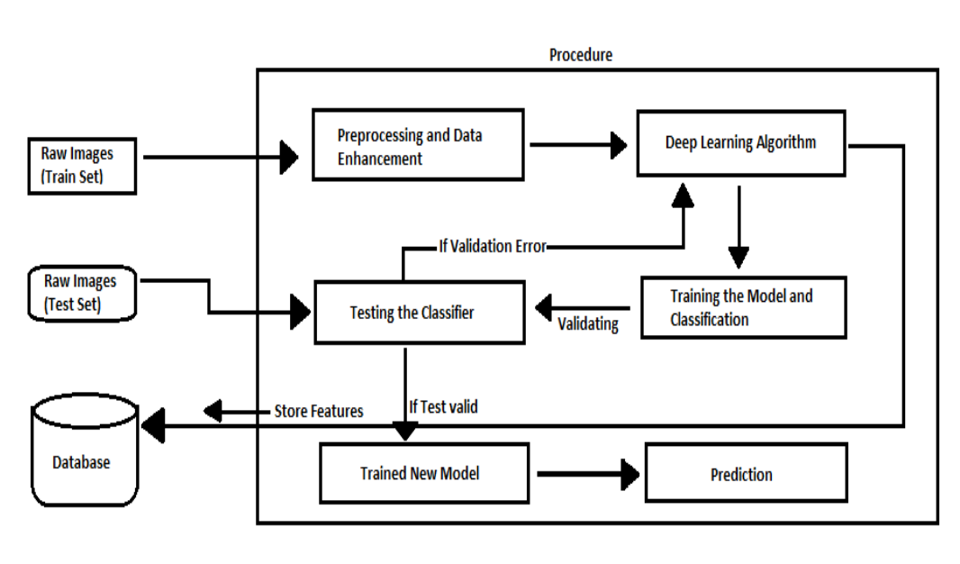
DIAGRAMS
Skin lesion analyzer

Slide 13
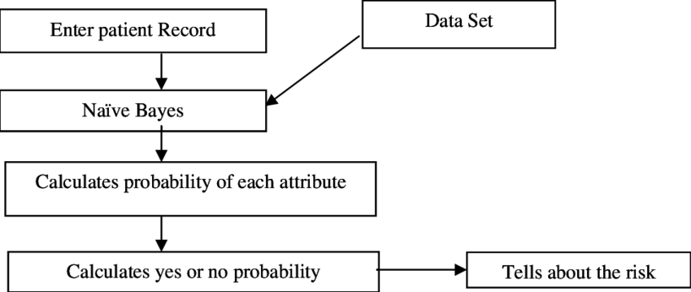
DIAGRAMS
Mental health disorder detection

Slide 14
CONCLUSION
Skin diseases are ranked as the fourth most common cause of human illness, but many still do not consult doctors. We presented a robust and automated method for the diagnosis of dermatological diseases. Treatments for skin are more effective and less disfiguring when found early. We should point out that it is to replace doctors because no machine can yet replace human input on analysis and intuition. Research in the European Society of Medical Oncology has shown for the first time that AI or ML is better than experienced dermatologists.
There are many algorithms in ML, like Decision Tree, Random Forest, and Naive Bayes, that help find mental health disorders. These algorithms produce better and more accurate disease-related results. It will reduce people's costs and medical expenses. Our mental health tracker provides an AR/VR meditation facility so anyone can get rid of these depressive symptoms and lead a healthy life.

